Slide 1
IE1020 Network Fundamentals Assignment - 01
Group ID - 30

Slide 2
Group Members
IT22253330 K.A.W.R.B.IDDAMALGODA
IT22339188 R.M.D.E. Rajapksha
IT22911858 S.A.H.D.M. Perera
IT22312594 D.K.D.G. Perera
IT22073082 E.M.B.Vihaga Bandara

Slide 3
Introduction
We have designed a network for the which is chain of XYZ University that has 7 branches
In order to the scenario, they have a main branch and 6 sub-branches for the network.
There are four faculties in each branch. Such as FOC, FOE, FOB, and FOA.
We have assigned IP addresses for 15000 IP-enabled devices in the main branch and more than 4000 devices in each sub-branch

Slide 4
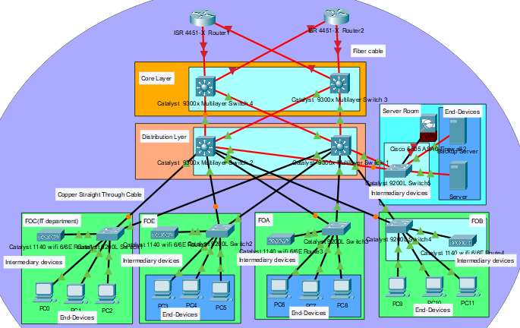
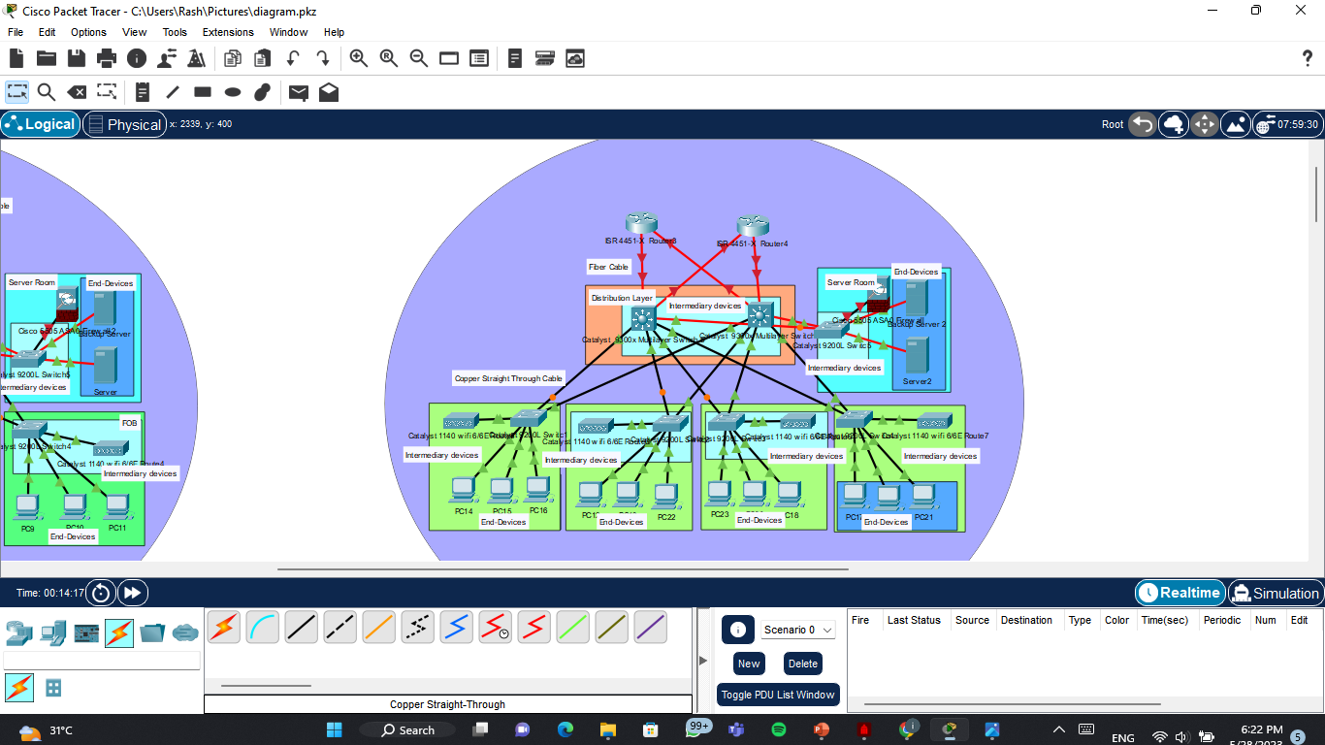
Logical Topology Diagrams'
Main branch Diagram
Sub Branch Diagram
All of sub branches architecture in this way

Slide 5

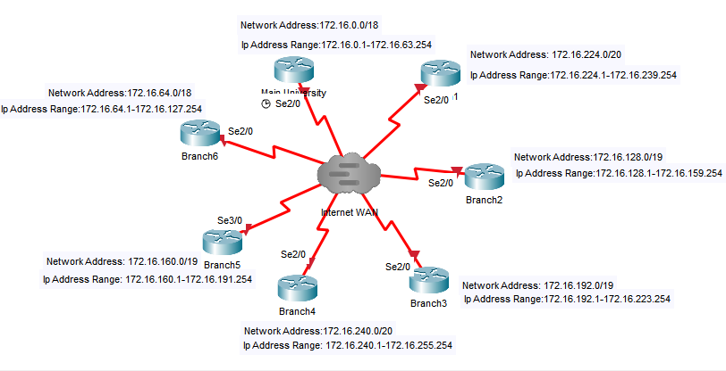
All branches connect from this way one branch represent In one router.

Slide 6
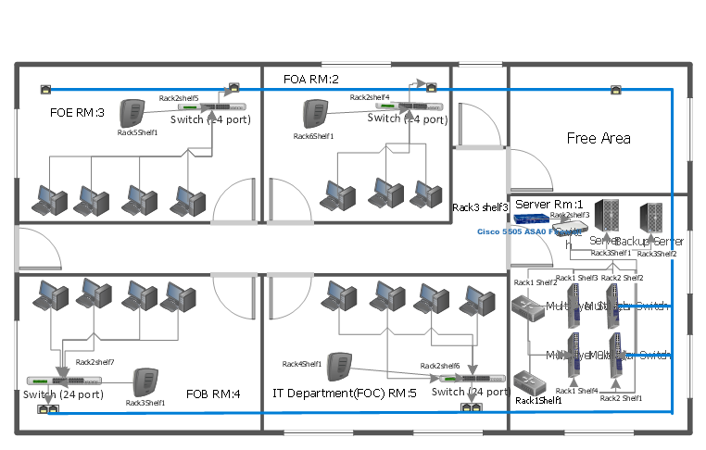
physical Topology Diagrams’
Main Branch

Slide 7

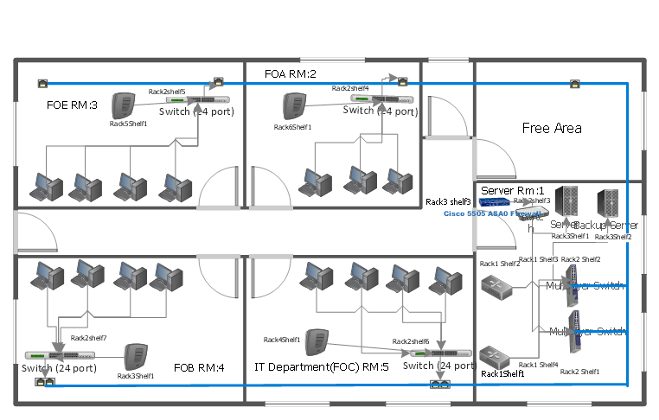
Sub Branch

Slide 8
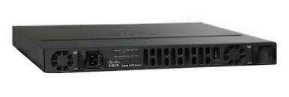
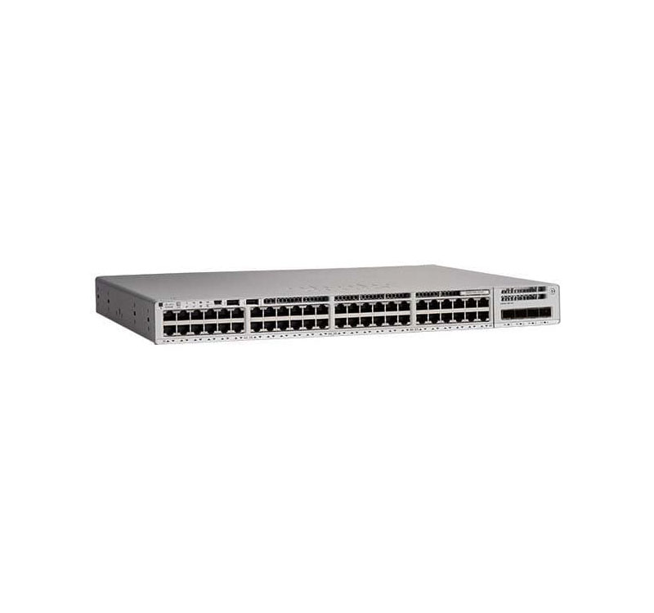
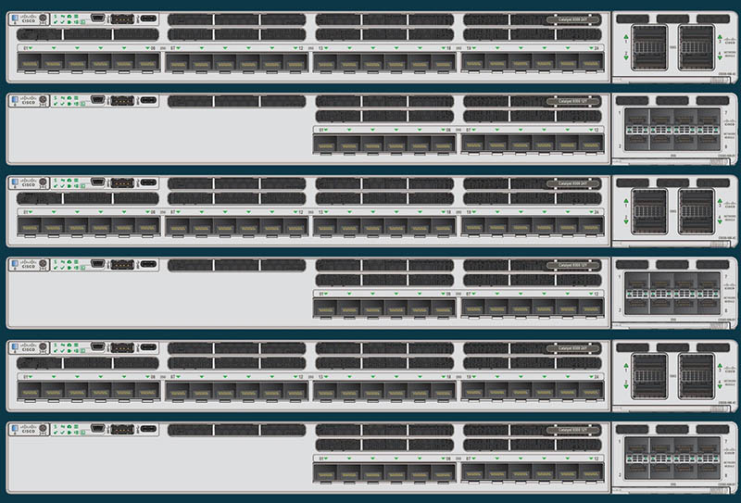
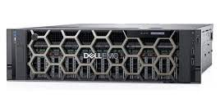
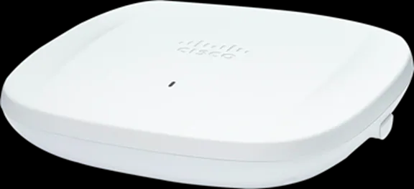
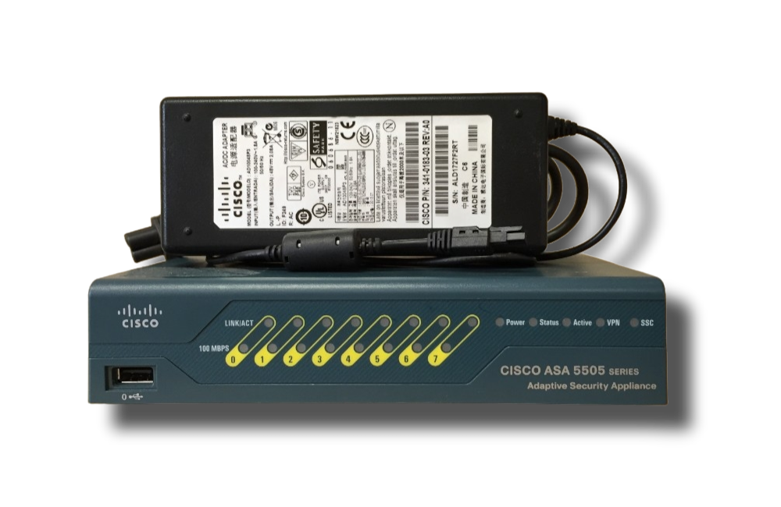
appropriate devices for the design
Routers – ISR 4431 Switches - C9200L
Multilayer Switch –
Cisco Catalyst 9300X
Servers –
Dell PowerEdge R940 Wireless Access Point –
Cisco Catalyst WIFI-6E
Cisco 5505 ASA0 Firewall

Slide 9
appropriate devices for the design
Device | Description
ISR 4431 Router | Integrated Service Router. This router has a 500 Mbps speed that can be increased to 1Gbps total speed. Features – High performance, Security, Best Bandwidth, Scalability
Cisco C9200L Switch | It is used for the access layer. Features – Ethernet connectivity at 1Gbps, High speed switching with a 56Gpbs capacity, Four fixed uplinks that run at 1Gbps.
Cisco Catalyst 9300X Multi Switch | Use in Core Layer and Distribution Layer Stackable switching bandwidth of up to 1 Tbps is available Features – Advanced security, Larger flash memory,
Dell PowerEdge R940 | High-end rack server It is built for workloads that are quite demanding
Cisco Catalyst WIFI-6E | Wireless access point. It has a high performance of up to 5.4 Gbps. Features – High-density, Two frequency (2.4GHz and 5GHz).
Firewall - Cisco ASA 5505 | This prevents cyber threats before they spread through the network. Memory – 256MB, Minimum system Flash – 64 MB. Maximum Firewall and IPS throughput up to 150Mbps.

Slide 10
appropriate media types for the design
Fiber Optic Cable
We placed fiber cables for Core Layer, Distribution Layer, and Server Room only
To get high performance be given without latency to the network.
Can transmit data 10 Gbps or over 10 Gbps and higher data rates
Fiber cable has the following advantages:
High Bandwidth
Security
Scalability and Futureproofing
Reliability and Low latency

Slide 11
appropriate media types for the design
Copper Straight through Cable (cat 6)
Used for connecting access layer, end-devices, and wireless access points.
Have stricter performance specifications and significantly higher data transfer speeds at greater distances.
There are some reasons for choosing it.
Cost-Effectiveness
Compatibility
Power Over Ethernet (POE) Support

Slide 12
appropriate LAN technologies for the design
The data packets are transmitted on the network and accepted by the computer interface with an exact match for the MAC address in the Ethernet frame.
The computers connect to the LAN by Copper Wires.
Switches are used to connect network cables.

Slide 13
appropriate WAN technologies for the design
Virtual Private Network (VPN) is most suitable for university networks.
A router gateway provides star network topology for interconnecting all LAN segments.
The local DNS server is configured and connected to this router.
It uses encryption and tunneling protocols to protect data transmission.

Slide 14
protocols
7. Application Layer
HTTP(Hypertext Transfer Protocol)
For web services.
Stateless connection.
ESMTP(Extended Simple Mail Transfer Protocol)
Used to send emails.
Include more security and authentication than SMTP.
DHCP(Dynamic Host Configuration Protocol)
To assign IP addresses automatically.
FTP(File Transfer Protocol)
Capable of sending large files.
Supports authentication and remote users can upload and download files.
Telnet
Allows to log in to remote host.

Slide 15
6. Presentation Layer
TLS(Transport Layer Security)
Guarantees the privacy of data exchanged between a client and a server.
Compress and Encrypt data.
Provide more security than SSL(Secure Sockets Layer).

Slide 16
5. Session Layer
SIP(Session Initiation Protocol)
Used for initiating, modifying, and terminating multimedia sessions over IP networks.
NetBIOS Protocol
Allows applications on computers to communicate with one another over a local area network.
ASP(Apple Talk Session Protocol)
Provides session establishment and maintenance services for Apple Talk applications.
LPP(Lightweight Presentation Protocol)
Provides session management services for IOT devices, allowing them to establish and maintain communication sessions.
RTCP(Real-Time Transport Control Protocol)
Responsible for providing control and monitoring of multimedia sessions, particularly in streaming applications.

Slide 17
4. Transport Layer
TCP(Transmission Control Protocol)
Reliable.
Connection-oriented.
Error checking when delivering data.
Control the flow.
UDP(User Datagram Protocol)
Connectionless.
Faster than TCP.

Slide 18
3. Network Layer
ARP(Address Resolution Protocol)
Given IP addresses to corresponding MAC addresses on a local network.
ICMP(Internet Control Message Protocol)
Reporting errors.
Testing network connectivity.
Providing diagnostic.
Control functions.
IPV4(Internet Protocol Version 4)
Addressing.
Routing capabilities.
IPV6(Internet Protocol Version 6)
Offer 128 bits addresses.
Enabling visually unique addresses.

Slide 19
2. Data Link Layer
Ethernet
Encapsulated and decapsulated the data.
Point-to-Point Protocol
Can establish a direct connection.
HDLC(High-Level Data Link Control)
Provide reliable and error-free transmission of data frames.
ATM(Asynchronous Transfer Mode)
Protocol used to reach high speed and low latency.
Wireless LAN Protocols
Provide wireless connection between devices.
Frame Relay
Used for transmitting data with each branch low latency and high speed.

Slide 20
IP addressing
Main Branch
No of Host | 15,000
Allocated Host Count | 16,382
Subnet mask | 255.255.192.0
Network Address | 172.16.0.0/18
Usable IP Range | 172.16.0.1-172.16.63.254
Host IP Range | 172.16.0.3-172.16.63.254
Sub Branch 1
No of Host | 4000
Allocated Host Count | 4094
Subnet mask | 255.255.240.0
Network Address | 172.16.224.0/20
Usable IP Range | 172.16.224.1-172.16.239.254
Host IP Range | 172.16.224.3-172.16.239.254
Sub Branch 2
No of Host | 8000
Allocated Host Count | 8190
Subnet mask | 255.255.254.0
Network Address | 172.16.128.0/19
Usable IP Range | 172.16.128.1-172.16.159.254
Host IP Range | 172.16.128.3-172.16.159.254

Slide 21
Sub Branch 3
No of Host | 6000
Allocated Host Count | 8190
Subnet mask | 255.255.254.0
Network Address | 172.16.192.0/19
Usable IP Range | 172.16.192.1-172.16.223.254
Host IP Range | 172.16.192.3-172.16.223.254
Sub Branch 4
No of Host | 4000
Allocated Host Count | 4094
Subnet mask | 255.255.240.0
Network Address | 172.16.240.0/20
Usable IP Range | 172.16.240.1-172.16.255.254
Host IP Range | 172.16.240.3-172.16.255.254
Sub Branch 5
No of Host | 7000
Allocated Host Count | 8190
Subnet mask | 255.255.224.0
Network Address | 172.16.160.0/19
Usable IP Range | 172.16.160.1-172.16.191.254
Host IP Range | 172.16.160.3-172.16.191.254
Sub Branch 6
No of Host | 13,000
Allocated Host Count | 16,382
Subnet mask | 255.255.192.0
Network Address | 172.16.64.0/18
Usable IP Range | 172.16.64.1-172.16.127.254
Host IP Range | 172.16.64.3-172.16.127.254

Slide 22
References
https://www.router-switch.com
https://www.cisco.com
www.dell.com

Slide 23
Any Question ?

Slide 24
Thank you.

